Slide 1
Horizon chasers
MENTAL HEALTH AWARENESS (HEAL AND CURE)
Team Details:
Lovekesh Bansal
7206637018
Team Members - 3

Slide 2
Description of the Project
Problem Statement
Approach to the Solution
With growing turmoil of Covid 19 and busy schedules of people it is important to rehabilitate mental health.
We initiated to build a chat bot to connect to user’s mind and then try to cure his depression through app.
Relevance to the Theme
Techstack Involved
MENTAL HEALTH AWARENESS : A solution to that would help people to deal with stress, anxiety and depression.
Flutter
ArtificIal Intelligence(IBM)

Slide 3
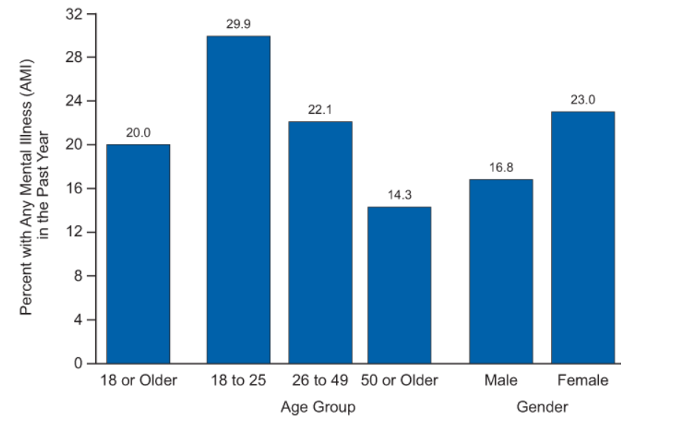
Novelty of the Solution
In past there has been rapid increase in mental health illness cases in youngsters, so there is need to build a solution that will help them to cure this mental health in interactive way. Also, to build awareness about importance of mental health.

Slide 4
Description of the Solution
Step 1
Step 2
Fetch details of user
Use a chat bot(IBM Watson) to interact with user.
2021
Step 3
Step 4
Analyse the mental health of user based on his/her interaction with IBM lite.
Cure and revive his/her mental health by using an interactive app.

Slide 5
Details of Technology Stack
A cross platform app development
Framework. Open source UI software development kit to develop applications for android, iOS, and web from single codebase.
Flutter
IBM Watson
(A.I.)
A interactive Artificial Intelligence platform (free of source )used to design software models as “question answering machines”.Powered by machine learning that helps to automate AI lifecycle.

Slide 6
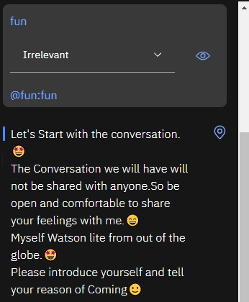
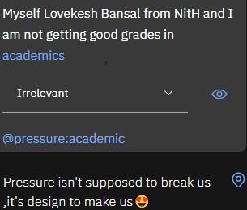
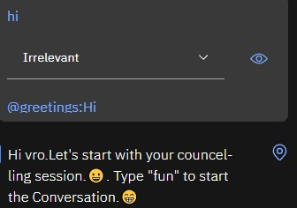
Progress Update
CHAT BOT LIVE USER INTERACTION

Slide 7
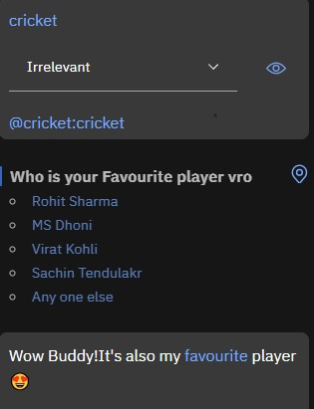
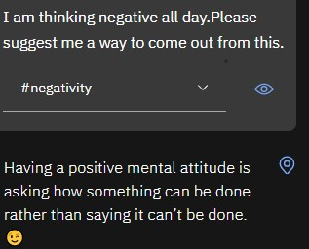
PROGRESS UPDATE
User friendly interaction will lighten the mood of user and he/she will be able to openly share his/her problems.
This way we will be able to cure them by analysing and measuring the range of depression.

Slide 8
Business Aspects of the Hack
01
Social Impact
This will help people especially youngsters to deal with early symptoms of stress, and anxiety.Moreover,their identity will not be revealed so they will be comfortable in sharing problems.
Target User
02
All youngsters who are reluctant to share about their mental health openly will benefit from this. Interactive platform and app for their benefit.
03
Financial Sustainability
Since there is not much development cost involved and it is user friendly.All the software used is free source and can be developed easily.
Since proper consideration is taken to keep system scalable and relatively less performance demanding, thus it can be reformed to product easily.Vast scope in future.
Product > Project
04

Slide 9
About Team
01
Lovekesh Bansal
Team Lead
02
Rashika Dubey
Team Member
03
Sai Shivam Kaushal
Team Member

